Slide 1
Catering By Les
If you can dream it we can do it

Slide 2
Tradition
Miami
DESIGN
Improvisation
Ethnic Cuisine
International Cuisine

Slide 3
"Pits" and "Spits" Re-purposing two exotic cooking methods that are too HOT to ignore

Slide 4
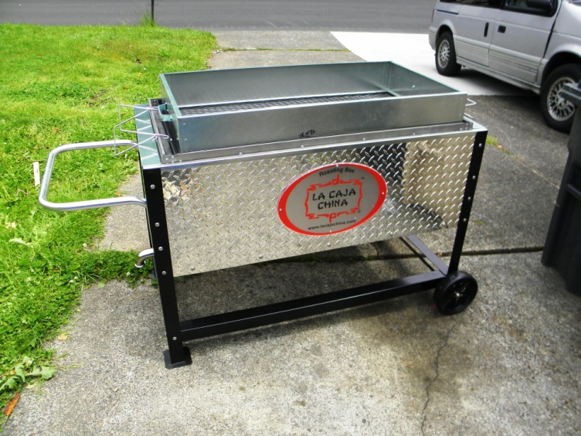
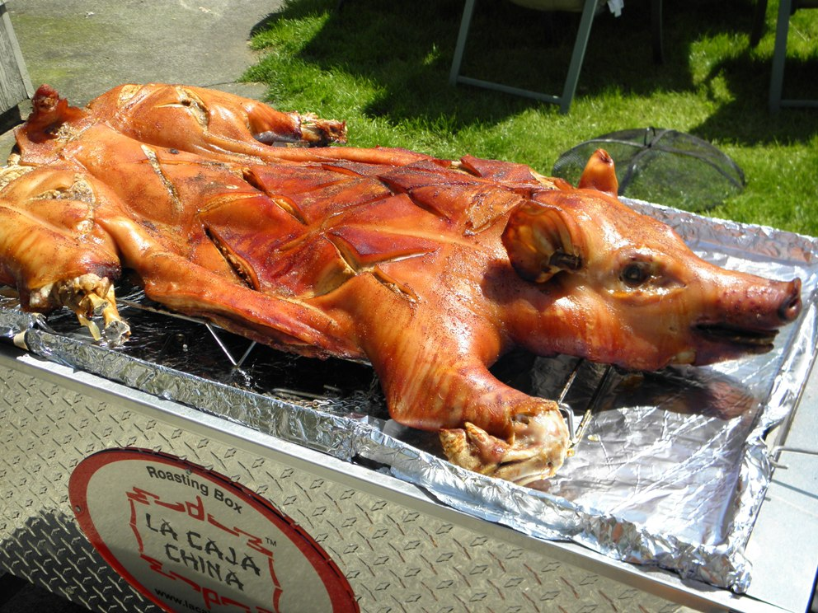
The "Pit"
La Caja China:
Also known as:
Roasting Box
The Clever Box
Cajun Microwave
Pits and Spits

Slide 5
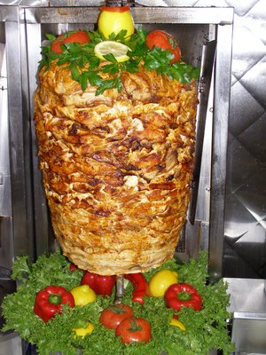
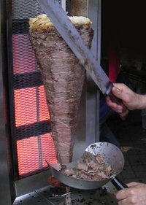
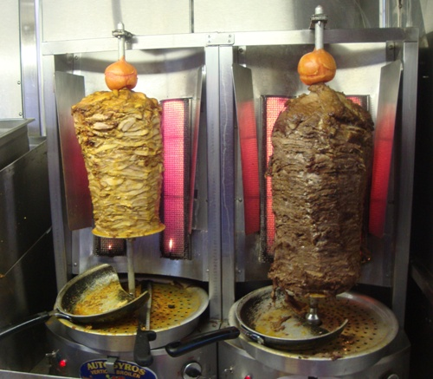
The "Spit"
Shwarma (Vertical rotisserie).

Slide 6
"Pits and Spits"
Two exotic & territorial cooking methods that are too HOT to be Ignored…
Get a feel for them…
Explore the Possibilities…
You are limited only by your Imagination…

Slide 7
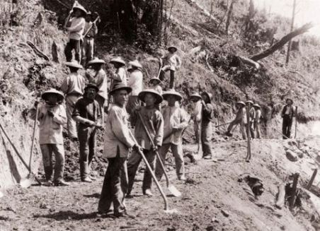
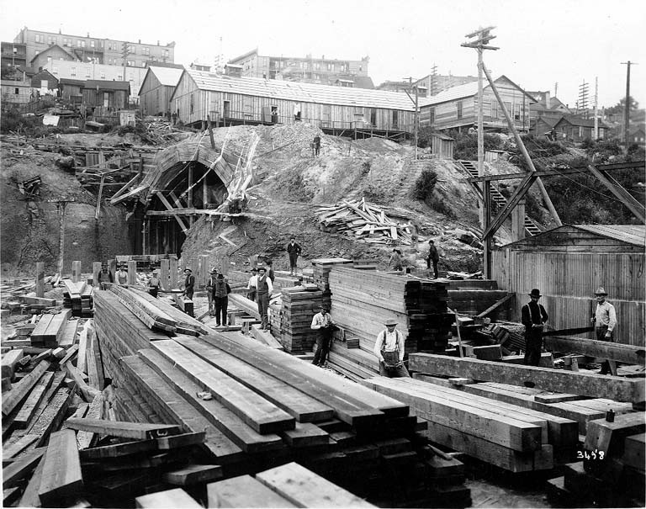
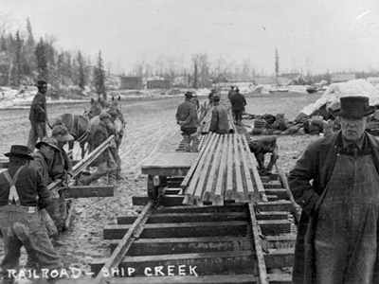
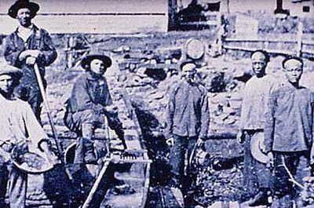
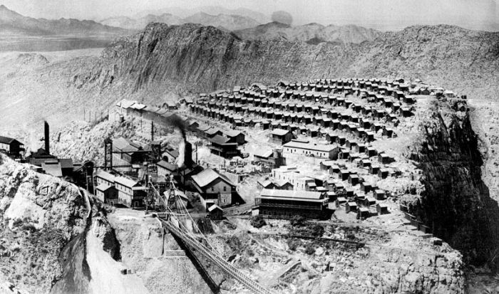
La Caja China: History

Slide 8
The Customary Use of La Caja China:
The Whole Pork Roast
Starts with:
A trip to the pig farm where you select your pig
Once home, apply seasoning and marinate
Mojo recipe
Preparation & cooking
Traditional Accompaniments.

Slide 9
Mojo Recipe
½ c Olive oil,extra virgin
Clove garlic, minced
1 1/2c Onion, sliced rings thin
2c Sour orange or fresh lime juice
½ tsp Ground oregano
½ tsp Salt
½ tsp Parsley flakes
¼ tsp Ground cumin

Slide 10
La Caja China

Slide 11
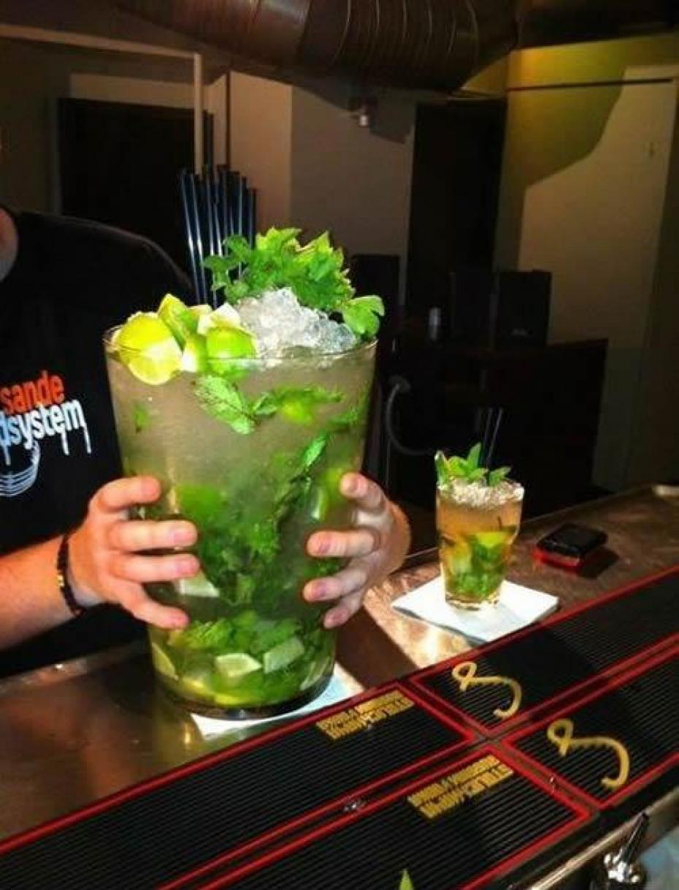
After all this work,
enjoy refreshing
Cuban Mojitos.

Slide 12
La Caja China
Roberto Guerra
“Patron Saint of Pig” The story .
Back in 1985 La caja china was born.
Inspired by Cuban tradition?.
Miami based company.
Customers across the country.
Only local materials.
The company growth.
La Caja China not only for pork.

Slide 13
La Caja China

Slide 14
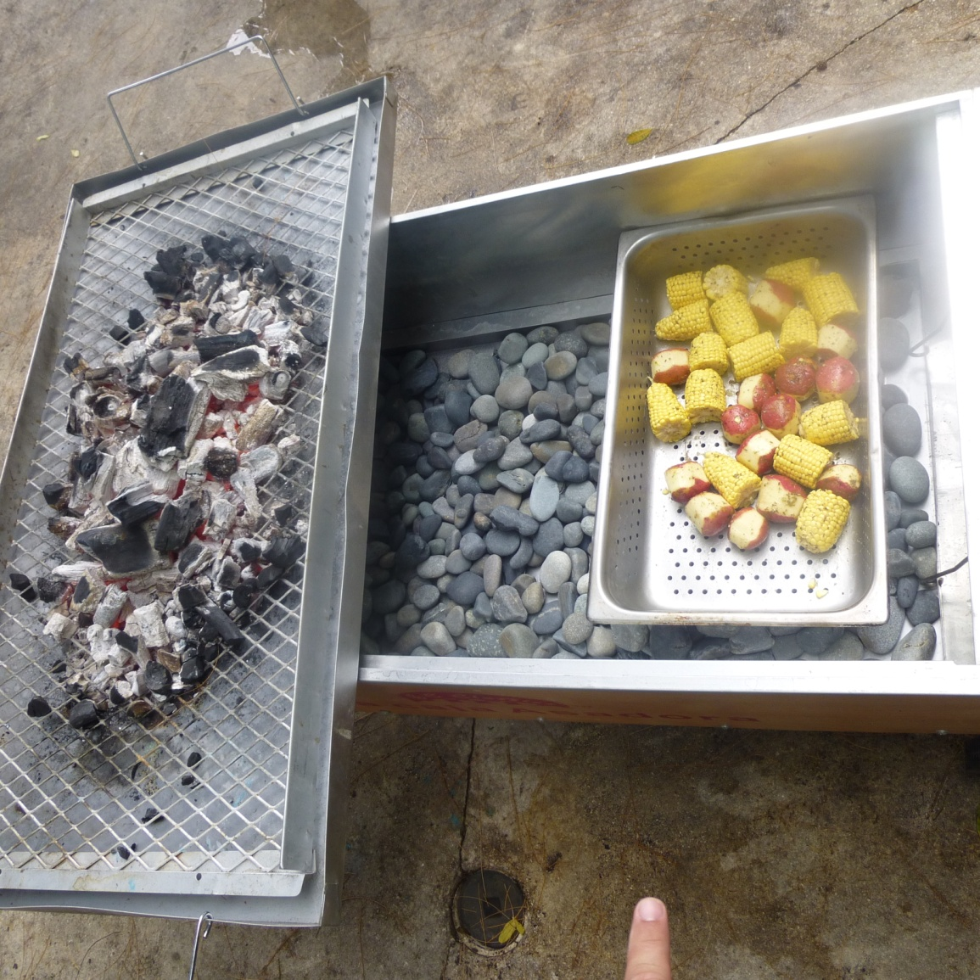
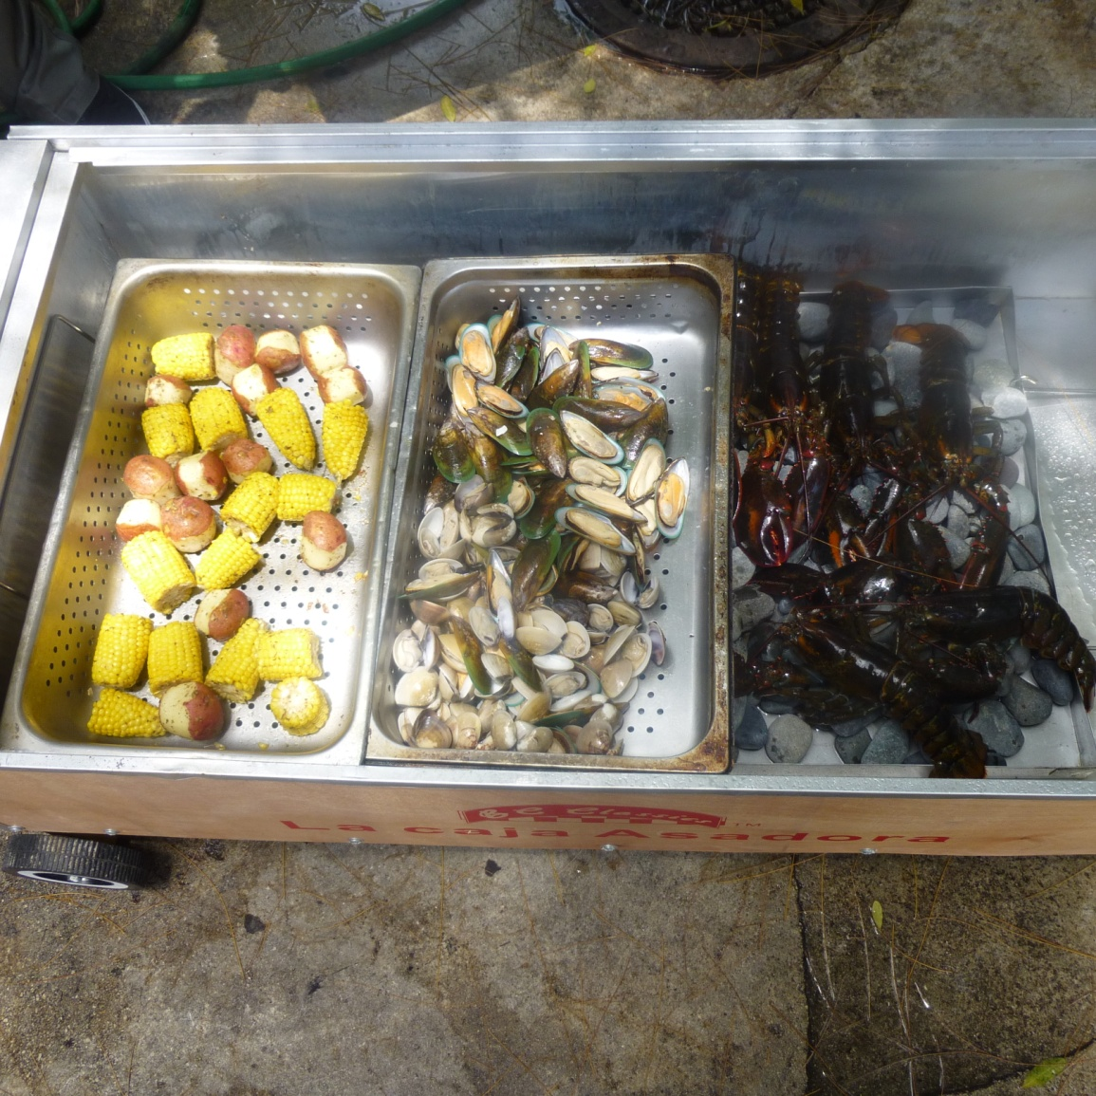
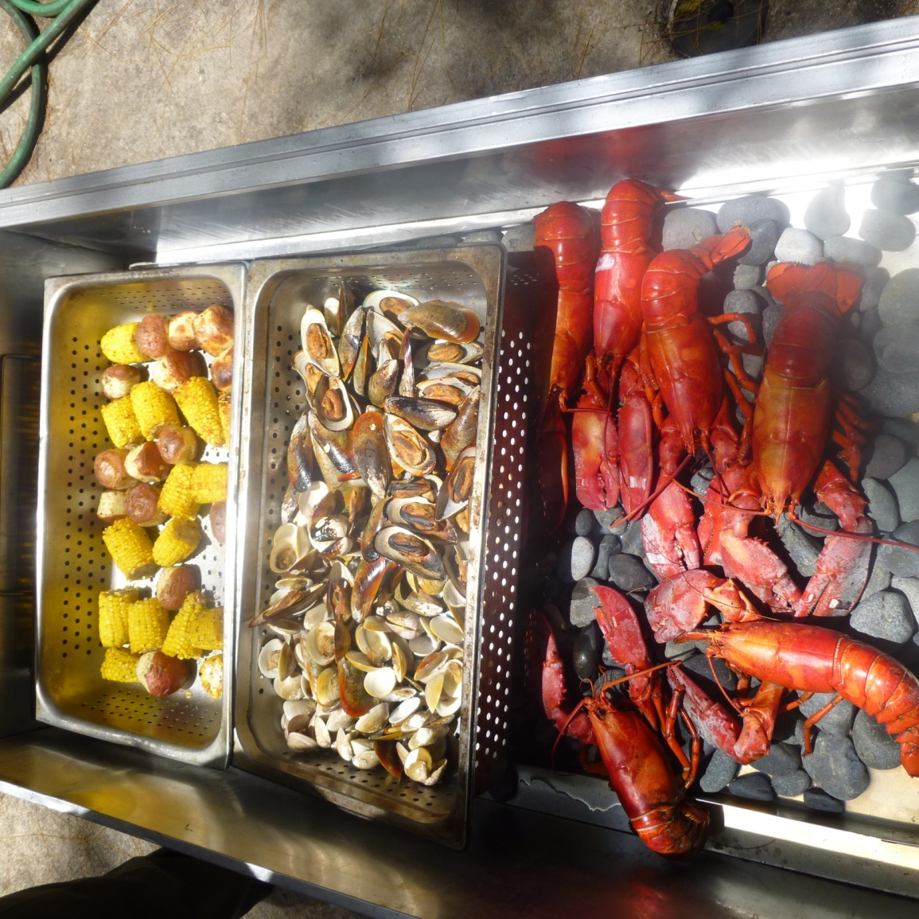
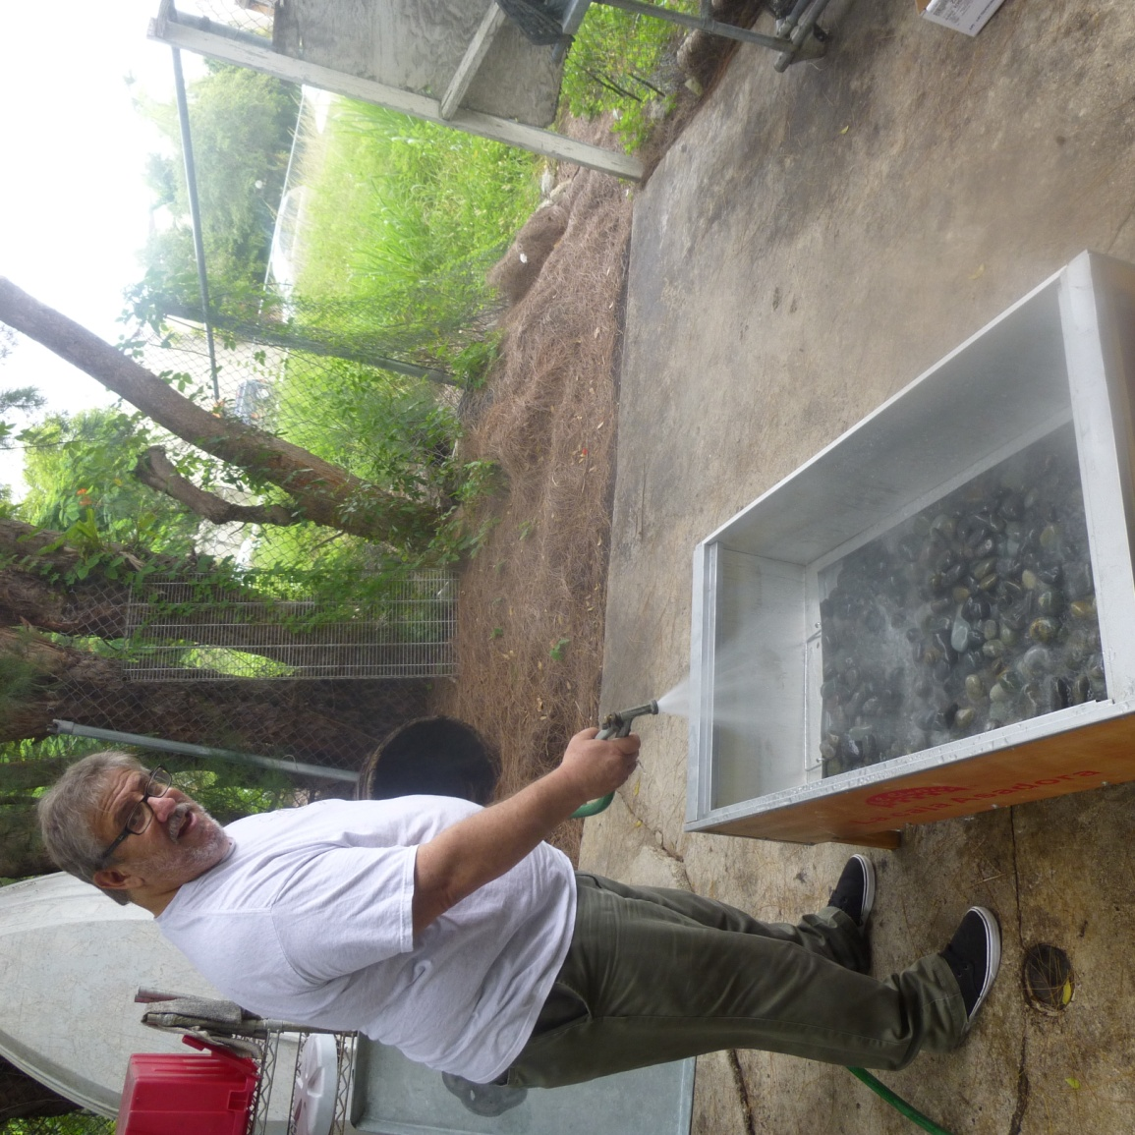
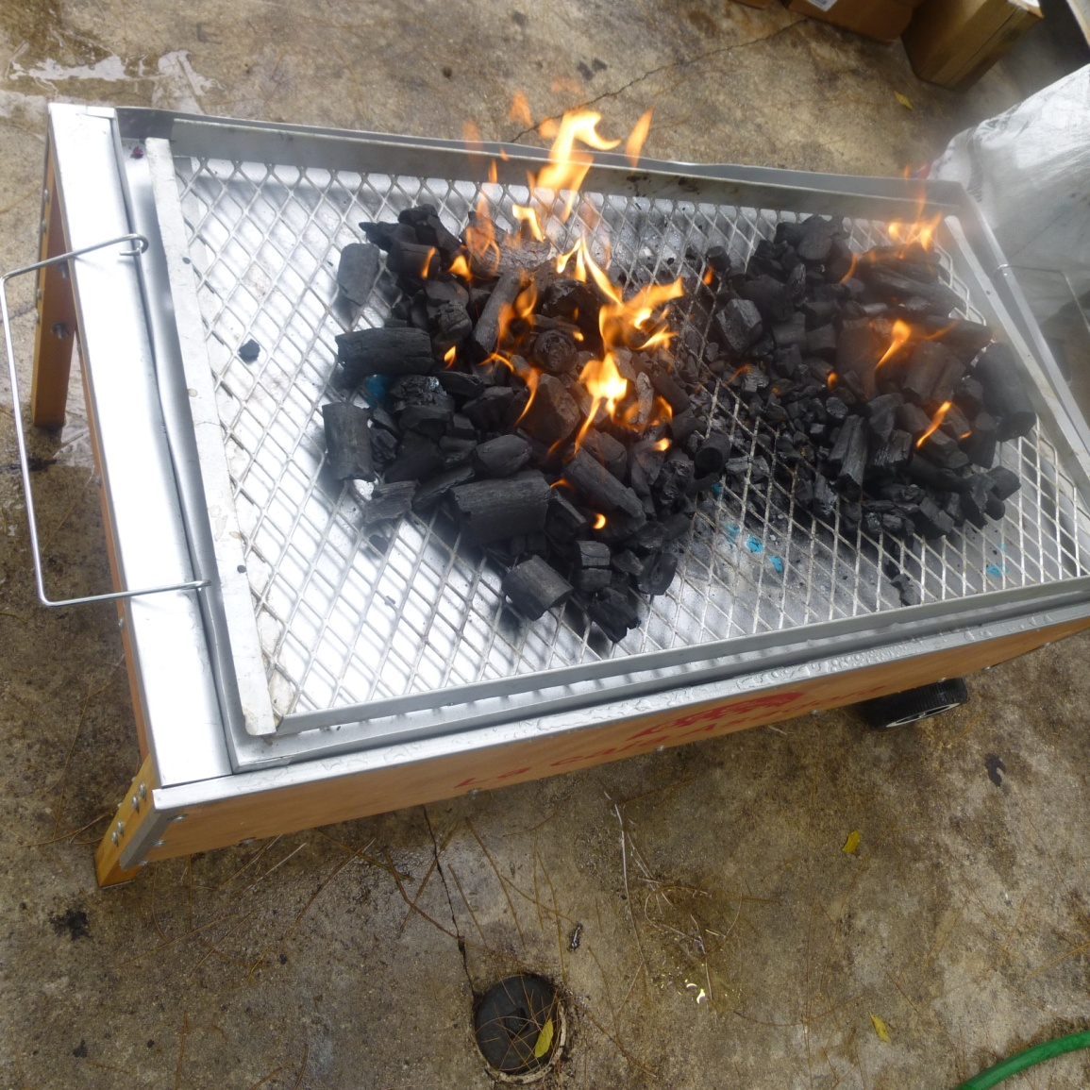
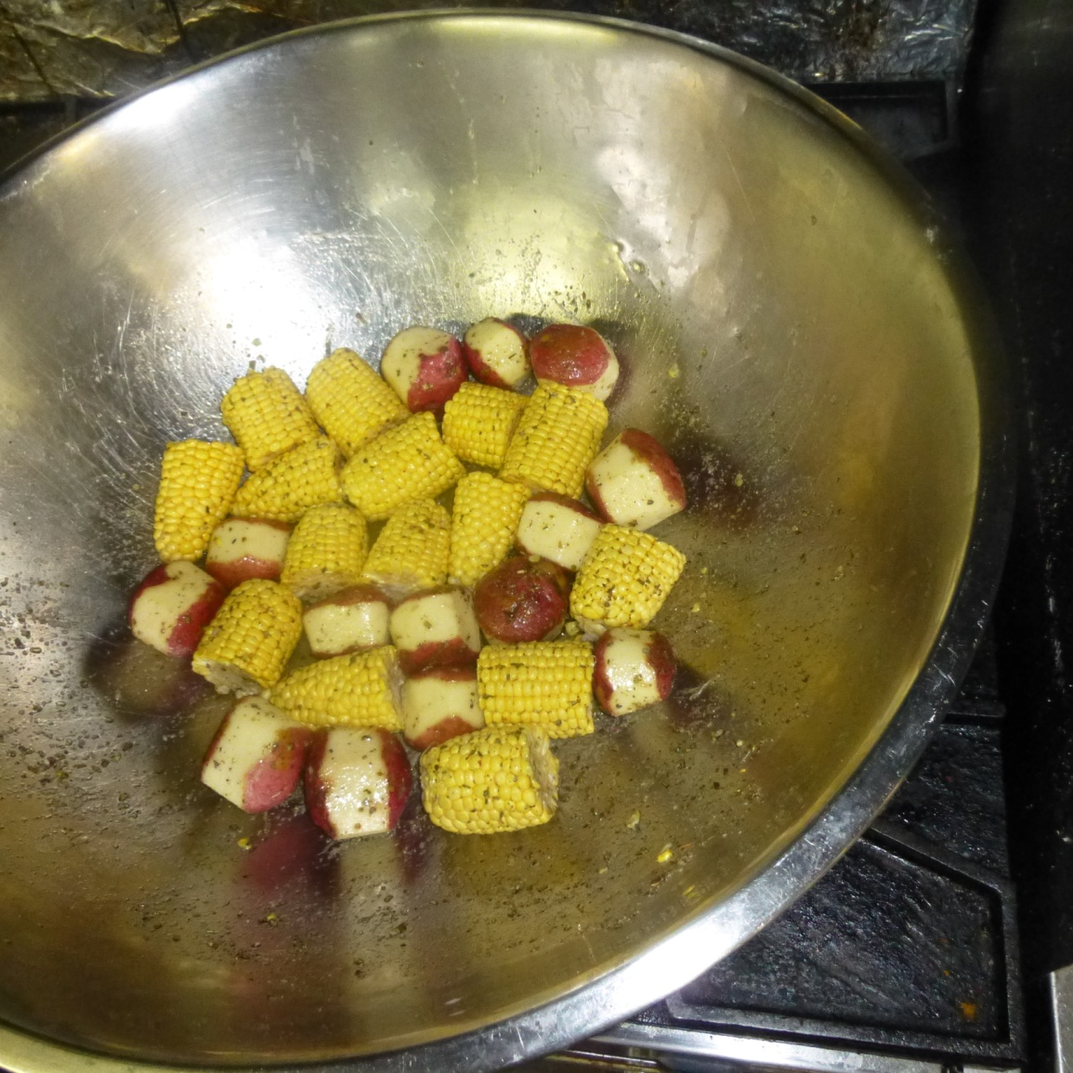
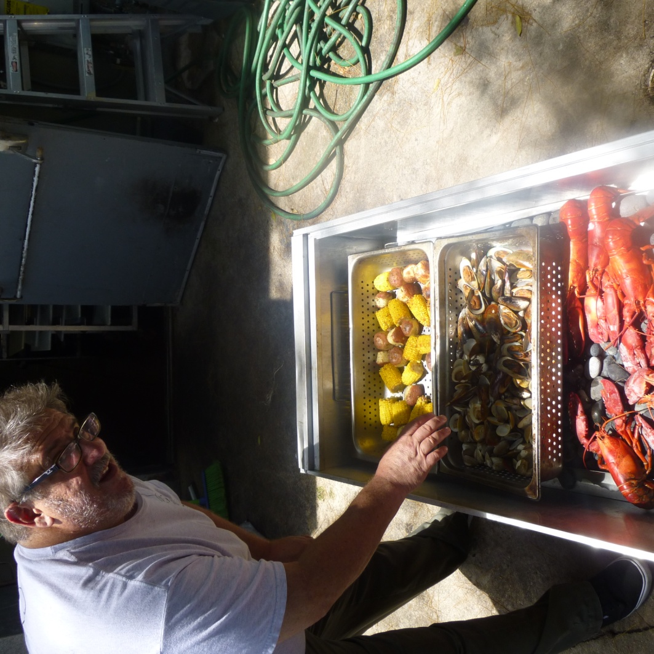
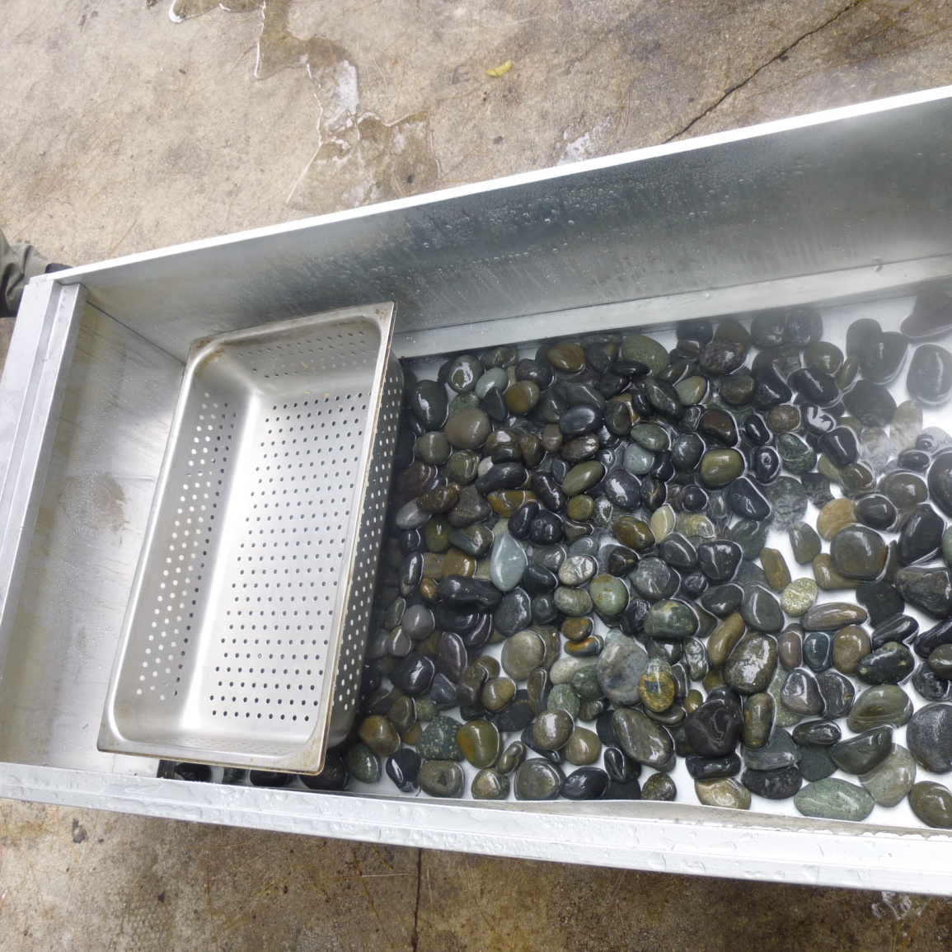
La Caja China
Use it as a STEAMER
New England Clam Bake.
Preparation:
River stones.
Dripping tray.
The fire.
Food strainer
The Food.

Slide 15
"Spit" Vertical Rotisserie

Slide 16
Vertical Rotisserie
A type of street food
Middle East
Meat, Sauce & toppings
The Greek gyro
The Turkish kebad
The Armenian dish tarna

Slide 17
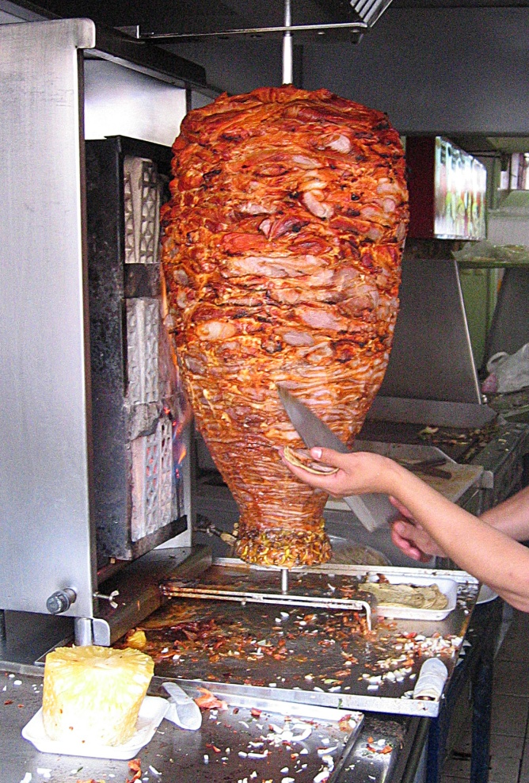
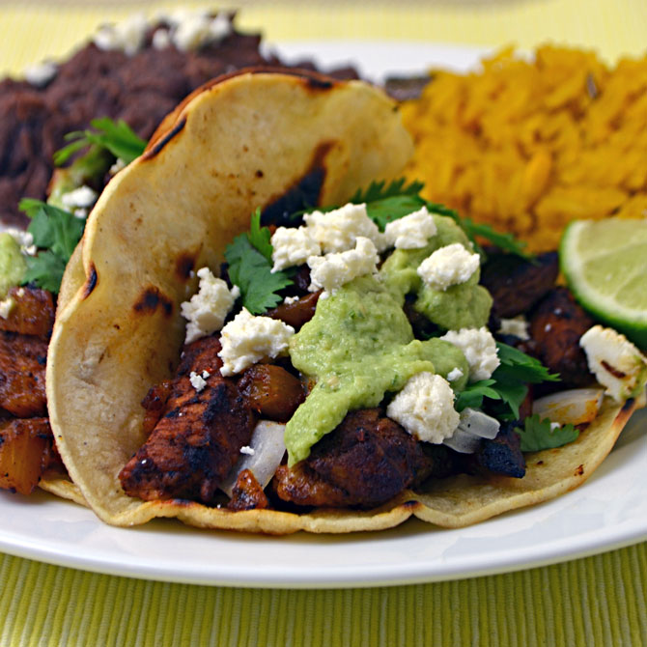
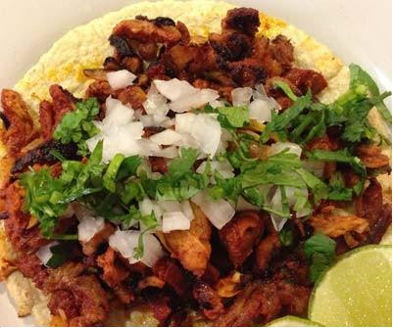
"Spits"
Tacos al pastor

Slide 18
Accompaniments: Flavored Waters from Mexico
Tamarindo
Ingredients:
10 tamarind pods
1 quart water
3/4 cups sugar, or to taste
Aqua de Jamaica
Ingredients:
1/2 cup of dried hibiscus calyces ("Flor de Jamaica")
Water (8 cups)
Sugar (about 1/2 cups, or to taste)
OPTIONAL: rum, ginger, thinly-sliced lime garnish
Horchata
Ingredients:
2/3 cup (120g) white rice
3 cups warm water
One 2-inch (5cm) cinnamon stick
3/4 to 1 cup (150g-200g) sugar
2 cups (500ml) rice milk or regular milk
Ground cinnamon, for serving

Slide 19
Questions & Answers

